Slide 1
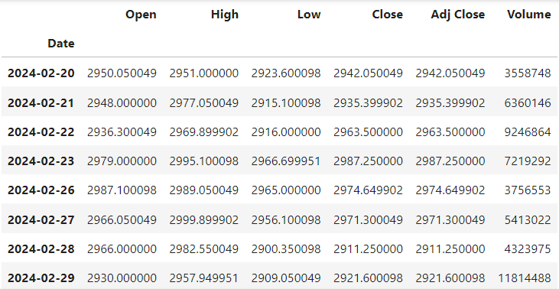
STOCK MARKET PREDICTION
Company Name – Reliance Industries
Algorithm Used : Linear Regression, Support Vector Machine, KNN, DT, Random Forest, LSTM
Features Used : Open, High, Low, Close
Input Data – 7 Days (1 week) (Only working days included)

Slide 2
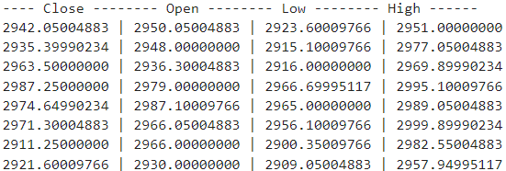
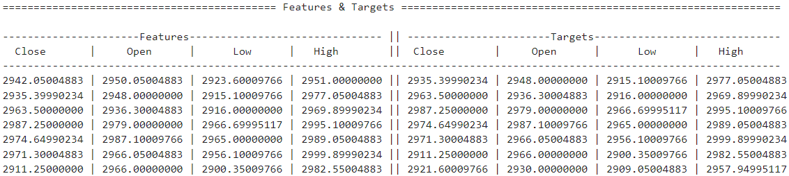
Block Diagram (Considering 7 Days)
INPUT DATA –
7 Days Stock Data
TRAINING DATA
MODEL
(ML ALGORITHMS)
Data use to predict the model

Slide 3
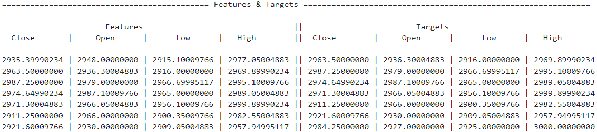
Block Diagram (Considering 7 Days)
Add (01/01/24) actual data to input data and remove the oldest one and again train the data
Predicted Close, Predicted Open, Predicted High, Predicted Low
Next Day(01/01/24) Predicted Prices
Next 10 Days prices predicted
Compared Actual and Predicted Prices
Plotting Actual and Predicted Prices

Slide 4
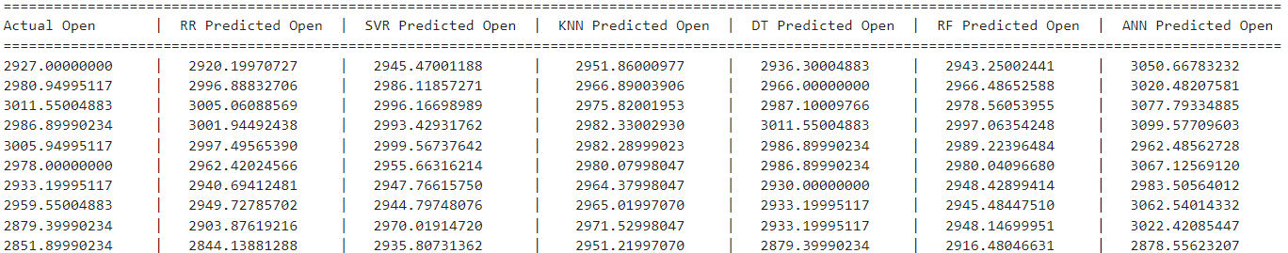
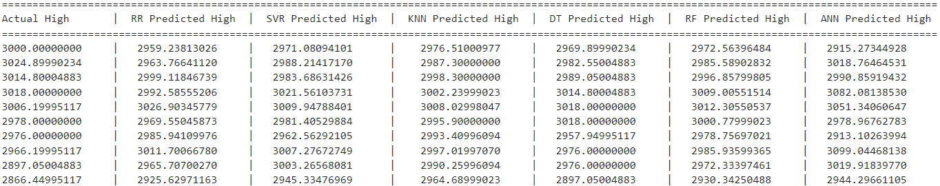
COMPARED ACTUAL AND PREDICTED PRICES
OPEN
HIGH

Slide 5
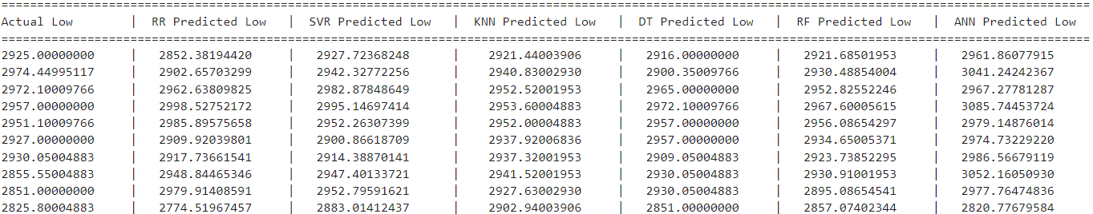
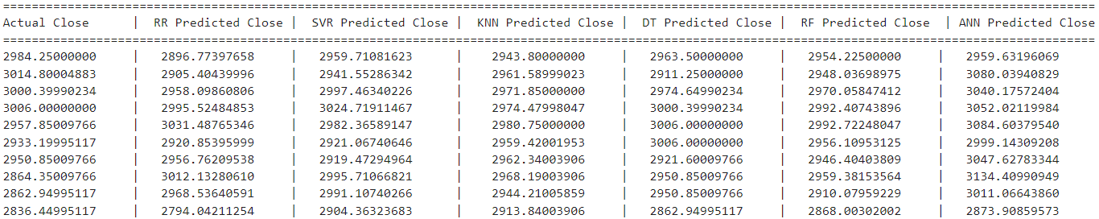
COMPARED ACTUAL AND PREDICTED PRICES
LOW
CLOSE

Slide 6
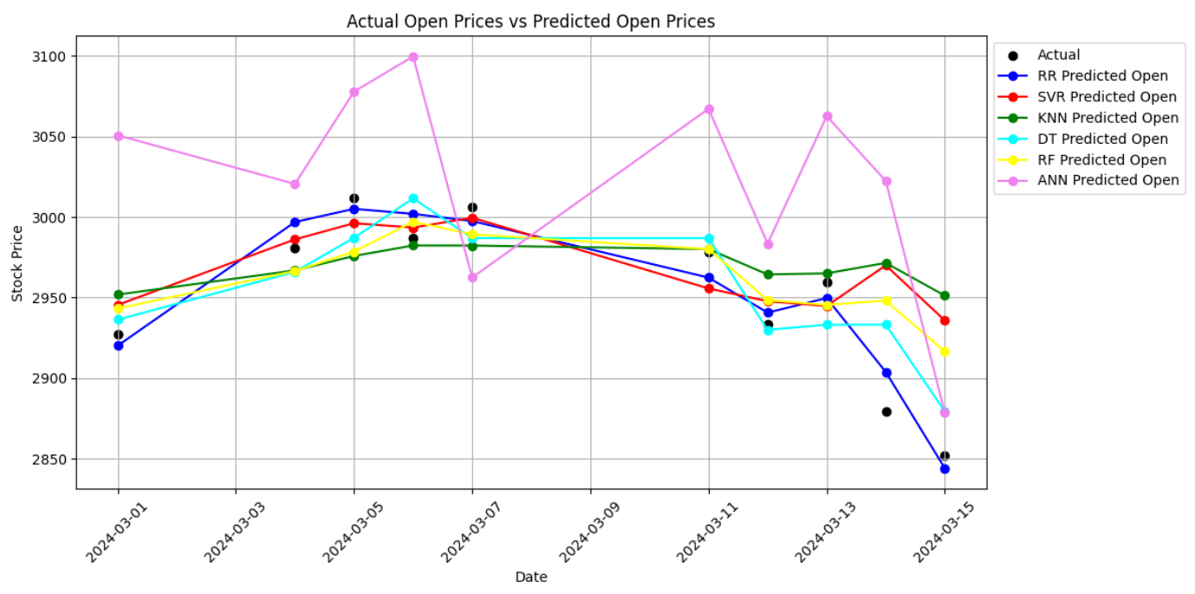
OPEN PRICE

Slide 7
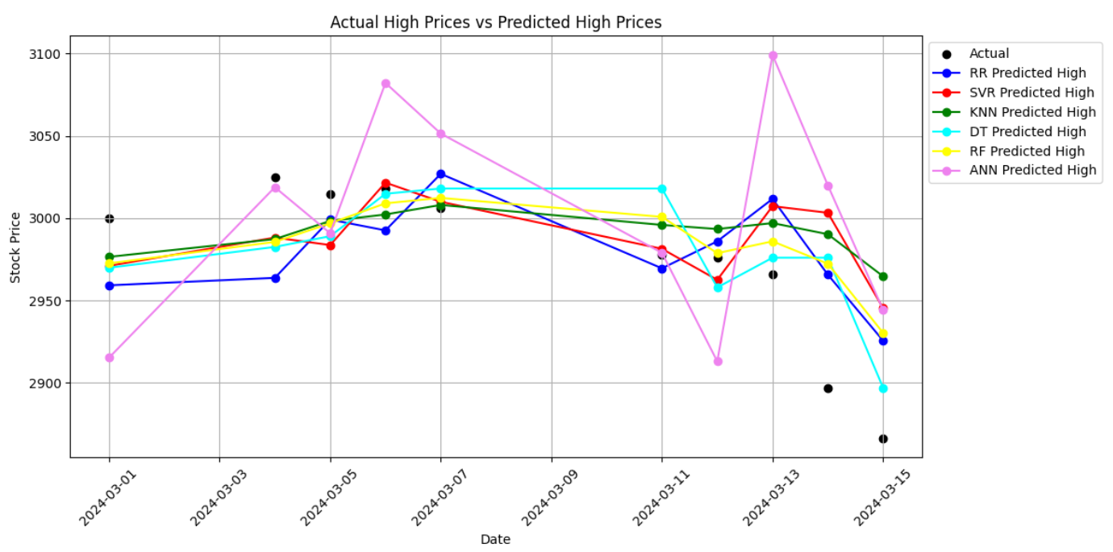
HIGH PRICES

Slide 8
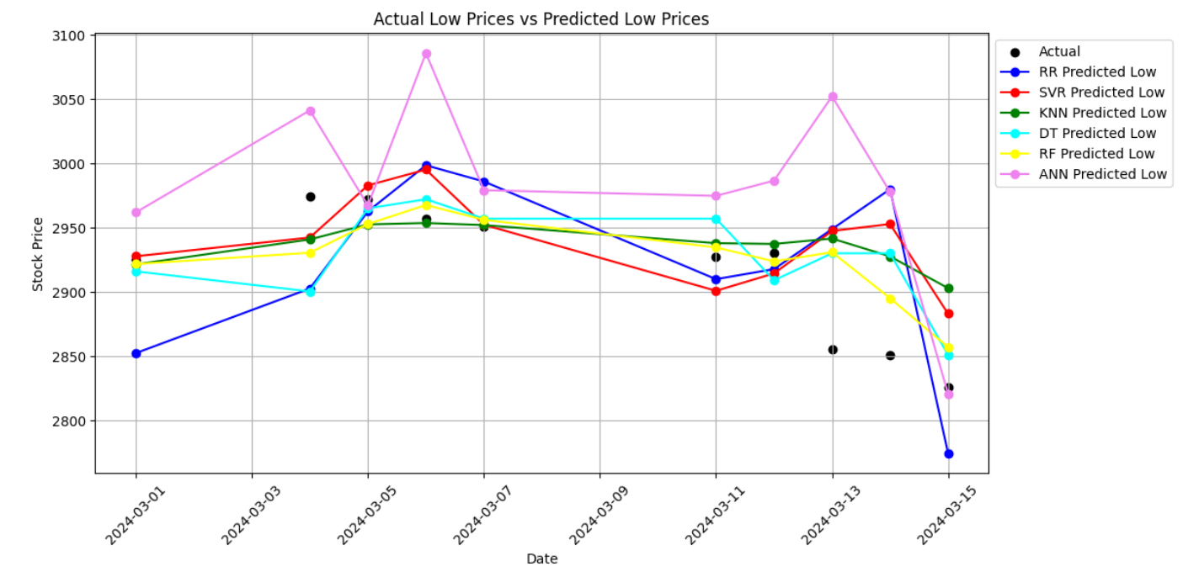
LOW PRICES

Slide 9
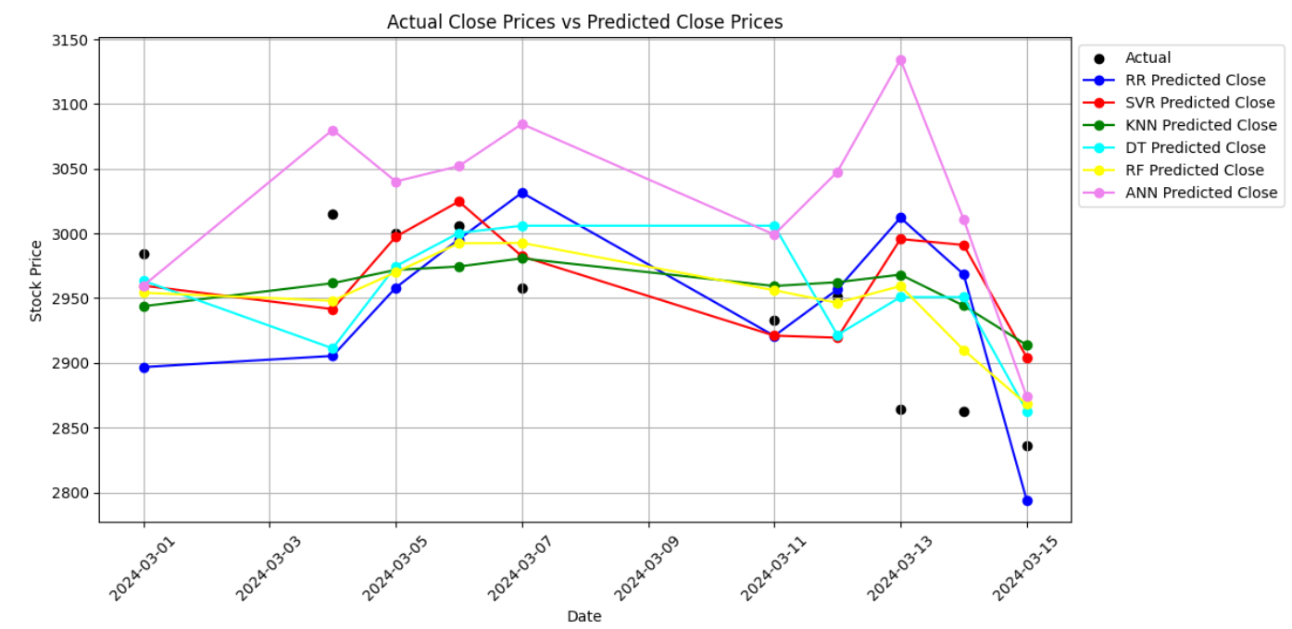
CLOSE PRICES

